Slide 1


Toxic Comment Filter Using NlP
Creators: Idan Ben David, Vlasy Baranov, Eliran Grinberg

Slide 2
Why Filter Comments
The internet has permeated nearly every aspect of our lives.
the internet has everything, its where we work , learn , hang out and find solutions to any question we have.
Yet the internet also has users who use the guise of anonymity to insult and spread hate, creating a toxic environment. Many sites , like Reddit , don’t have a safe mode that prevents the appearance of these comments ,that can offend , enrage or mentally harm other users of the internet.
This is exactly the reason why filtering is needed, to ensure
an overall good environment for the average user that surfs the net

Slide 3
What Is NLP
Natural Language Processing is a field in machine learning that gives machines the ability to not just read, but to understand and interpret human language. With NLP, machines can make sense of written or spoken text and perform tasks including text classification, speech recognition, sentiment analysis , and automatic text summarization.

Slide 4
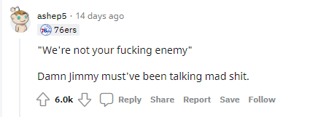

How We Use NLP
We use NLP to analyze the meaning of written text (comment) in order to classify whether it is Offensive/Toxic and if so, filter/censor them off the web page.

Slide 5
Why Not Just Use Dictionary For Bad Words?
There are many words that could have different meanings depending on the context. Words that are used in everyday conversations could also be used to offend/insult others
For example , the word “Dog” , can be used in an offensive way , it can also be used to describe an animal.
For the model to get a better understanding of the context, using an RNN model for the classification is the way to go

Slide 6
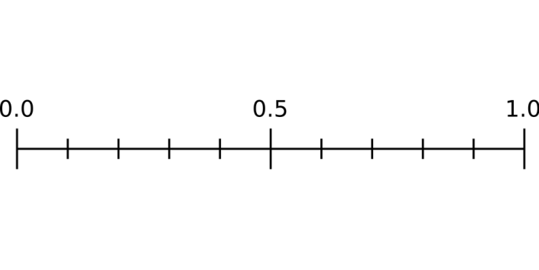
Comment Toxicity RNN Model Score Examples:
Safe
Toxic
“You’re a dog” – Score -> 0.70648
“I have a great dog” – Score -> 0.16324
“You’re a good sport” – Score -> 0.06276

Slide 7
The steps of NLP
1. Normalization - Remove Punctuation, Special characters and expanding contractions
2. Tokenization – Separates text into single words
3. Removing stop words – (Not used). Stop words are necessary to understand toxic/offensive context
4. Stemming/Lemmatizing – (Not used). Reducing words to their stem, may affect the score of negativity in different sentences into the same score , when in the reality they should be different.
Example: ‘hated’ vs ‘ hates’ . ‘hated’ gets more negative score by VADER (Model for text sentiment)
5. Vectorizing – Encoding The result of the Tokenization into numeric form, Using TF-IDF (computes relative frequency that a word appears in the dataset).
6. Padding – Makes the inputs same size, by adding 0’s to their end to match length of 200.

Slide 8
Normalization
Cleaning the text : Expanding contractions, removing punctuations, and special characters
“ @@ Thanks much – however if it’s been resolved, why it’s that today , when I didn’t write anything in edit summary ”
“thanks much however if it is been resolved why it is that today when I did not write anything in edit summary”

Slide 9
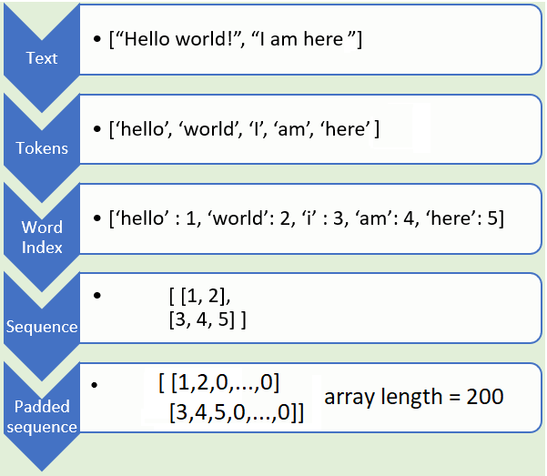
Tokenizing , Vectorizing and Padding

Slide 10
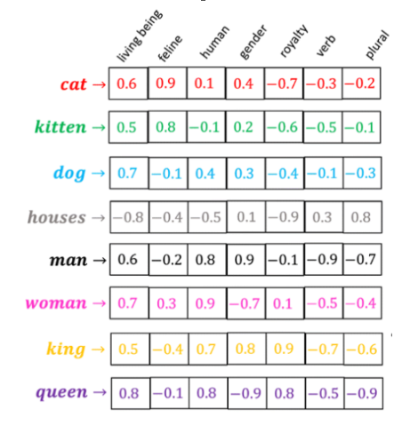
Embedding
Word embeddings are a class of techniques where individual words are represented as real-valued vectors in a predefined vector space. Each word is represented by a real-valued vector, often tens or hundreds of dimensions. This is contrasted to the thousands or millions of dimensions required for sparse word representations, such as a one-hot encoding.
The distributed representation is learned based on the usage of words. This allows words that are used in similar ways to result in having similar representations, naturally capturing their meaning.

Slide 11
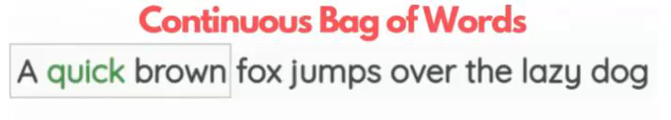
Transfer Learning
However, to train an embedding layer to understand the relations between words you would need to train it on large datasets beyond the scope of the supervised training datasets. and since this unsupervised learning process is lengthy and hard to properly evaluate we decided to utilize transfer learning and use pre-trained word embedding and use these representations for training a supervised target task using labelled data
in our project we decided to use FastText pre-trained word embeddings trained using CBOW to understand context and semantics

Slide 12
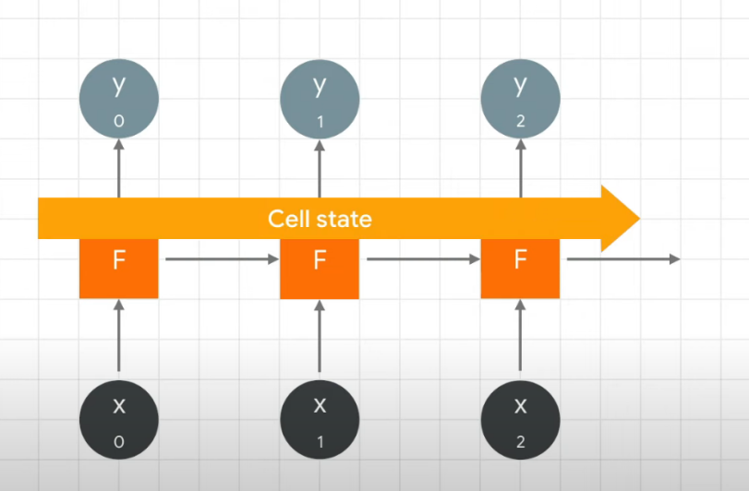
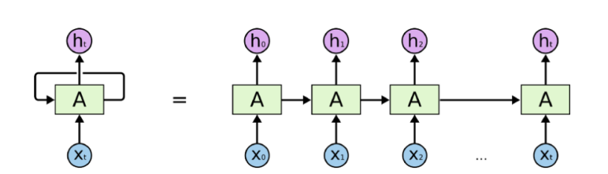
RNN - LSTM
Recurrent neural network is a type of neural network used to deal specifically with sequential data. Actually what makes RNN so powerful is the fact that it doesn't take into consideration just the actual input but also the previous input which allows it to memorize what happens previously.
LSTM — Long short term memory is an improvement over RNN to address RNN’s failure to learn in the presence of past observations greater than 5–10 time steps between relevant input and target. LSTM does so by introducing a memory unit called “cell state”. This cell state carries information or context over longer steps

Slide 13
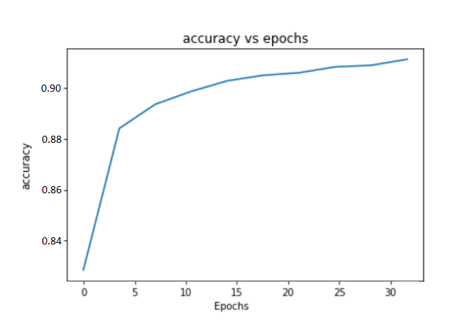
LSTM MODEL
91.2% Test Accuracy (30 epochs)

Slide 14
Chrome Extension And How We Use It
Chrome Extensions are small software programs that customize the browsing experience.
They enable users to tailor Chrome functionality and behavior to individual needs or preferences.
They are built on web technologies (HTML,CSS,JS)
We let the user browse the web safely by censoring comments with an offensive/toxic intent.
How we manipulate the comments.
Every comment is identified by the same class id.
We iterate through all the elements that have the comment class id , then we send the element's text to the model, receive back an answer and censor/keep the text according to the model’s answer.

Slide 15




How it works
User enters Google chrome
Content script searches for all the comments and sends requests to Extension background
Extension’s background uses the model to classify each comment
Depending on response extension censors or keeps the comment on the web page
Extension responds back with the result

Slide 16
No Server Needed
The RNN model was trained in python and converted to a TensorFlowJs model that is saved in local storage.
The Extension loads the model whenever the user opens google
chrome and then accesses it asynchronously for every comment,
giving the user a fast latency-free experience

Slide 17






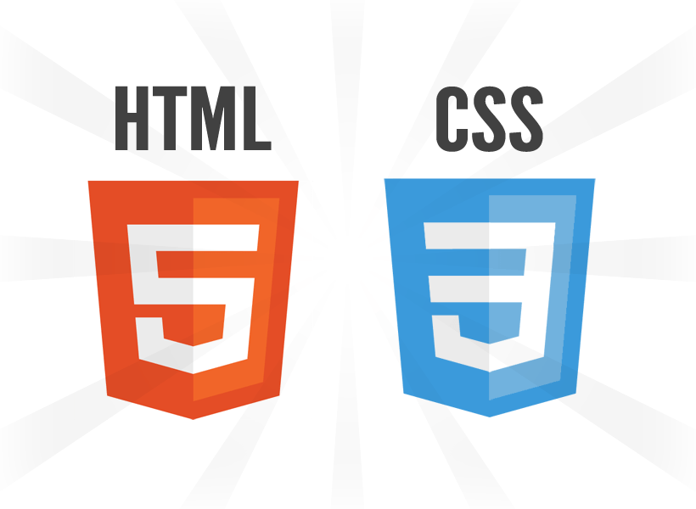



Technologies:
Chrome Extension

Slide 18
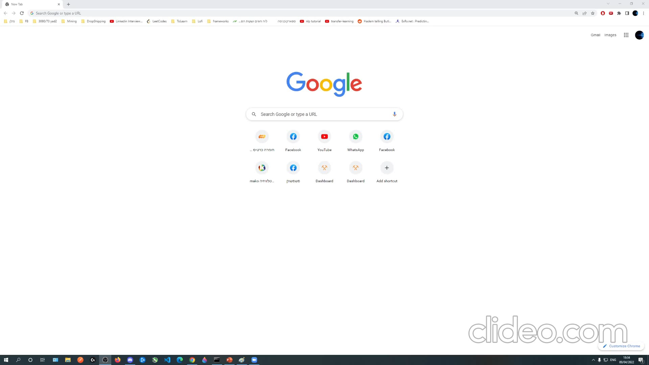
Demonstration

Slide 19
Thank you!
Now we would like to answer your questions

